Slide 1
4
INTEGRALS

Slide 2
4.5
The Substitution Rule

Slide 3


The Substitution Rule
Because of the Fundamental Theorem, it’s important to be able to find antiderivatives. But our antidifferentiation formulas don’t tell us how to evaluate integrals such as
To evaluate this integral our strategy is to simplify the integral by changing from the variable x to a new variable u.
Suppose that we let u be the quantity under the root sign in u = 1 + x².
Then the differential of u is du = 2x dx.

Slide 4


The Substitution Rule
Notice that if the dx in the notation for an integral were to be interpreted as a differential, then the differential 2x dx would occur in and so, formally, without justifying our calculation, we could write

Slide 5

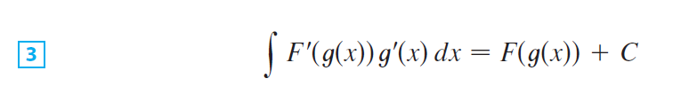
The Substitution Rule
But now we can check that we have the correct answer by using the Chain Rule to differentiate the final function of Equation 2:
In general, this method works whenever we have an integral that we can write in the form

Slide 6


The Substitution Rule
because, by the Chain Rule,
If we make the “change of variable” or “substitution”
u = g(x), then from Equation 3 we have
or, writing F’ = f, we get

Slide 7
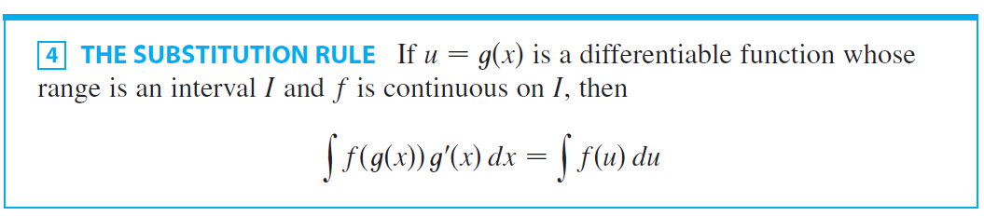

The Substitution Rule
Thus we have proved the following rule.
Notice that the Substitution Rule for integration was proved using the Chain Rule for differentiation. Notice also that if
u = g(x), then du = g’(x)dx, so a way to remember the Substitution Rule is to think of dx and du in as differentials.

Slide 8
The Substitution Rule
The Substitution Rule says: It is permissible to operate with dx and du after integral signs as if they were differentials.

Slide 9

Example 1
Find

Slide 10




Example 1- Solution
SOLUTION:
We make the substitution u = x⁴ + 2 because its differential is and the Substitution Rule, we have
Notice that at the final stage we had to return to the original variable x.

Slide 11


The Substitution Rule
The idea behind the Substitution Rule is to replace a relatively complicated integral by a simpler integral. This is accomplished by changing from the original variable x to a new variable u that is a function of x.
Thus in Example 1 we replaced the integral
by the simpler integral
The main challenge in using the Substitution Rule is to think of an appropriate substitution.

Slide 12
The Substitution Rule
You should try to choose u to be some function in the integrand whose differential also occurs (except for a constant factor). This was the case in Example 1.
If that is not possible, try choosing u to be some complicated part of the integrand (perhaps the inner function in a composite function).
Finding the right substitution is a bit of an art. It’s not unusual to guess wrong; if your first guess doesn’t work, try another substitution.

Slide 13

Example 2
Evaluate

Slide 14

Example 2 - Solution
SOLUTION:
Solution 1 Let u = 2x + 1. Then du = 2 dx, so dx = du.
Thus the Substitution Rule gives

Slide 15



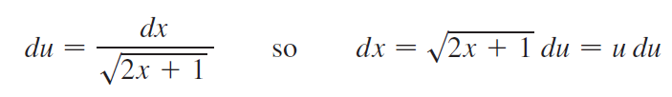
Example 2 – Solution
cont’d
Solution 2 Another possible substitution is
Then
(Or observe that u² = 2x + 1, so 2u du = 2 dx.)

Slide 16


Example 2 – Solution
cont’d
Therefore

Slide 17
Example 3
Find
SOLUTION
Let u = 1 – 4x².
Then, du = – 8x dx.
So, x dx = – 1/8 du and

Slide 18
SUBSTITUTION RULE
The answer to the example could be checked by differentiation.
Instead, let’s check it with a graph.

Slide 19
SUBSTITUTION RULE
Here, we have used a computer to graph both the integrand and its indefinite integral
We take the case C = 0.

Slide 20
SUBSTITUTION RULE
Notice that g(x):
Decreases when f(x) is negative
Increases when f(x) is positive
Has its minimum value when f(x) = 0
So, it seems reasonable, from the graphical evidence, that g is an antiderivative of f.

Slide 21

Example 4
Calculate

Slide 22

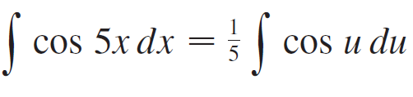

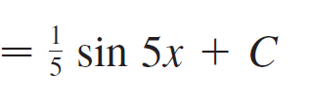
Example 4 – Solution
SOLUTION:
If we let u = 5x, then du = 5dx, so dx = du. Therefore

Slide 23

The Substitution Rule
NOTE With some experience, you might be able to evaluate integrals like these without going to the trouble of making an explicit substitution.
By recognizing the pattern in Equation 3, where the integrand on the left side is the product of the derivative of an outer function and the derivative of the inner function, we could work Example 1 as follows:

Slide 24

The Substitution Rule
Similarly, the solution to Example 4 could also be written like this:

Slide 25
Definite Integrals

Slide 26
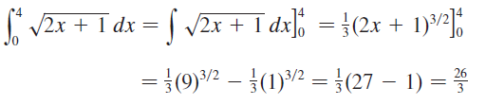
Definite Integrals
When evaluating a definite integral by substitution, two methods are possible.
One method is to evaluate the indefinite integral first and then use the Evaluation Theorem.
For instance, using the result of Example 2, we have

Slide 27
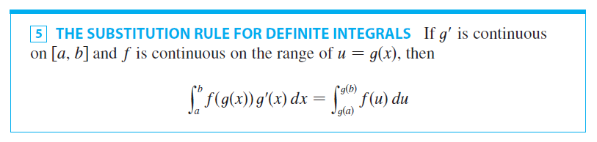
Definite Integrals
Another method, which is usually preferable, is to change the limits of integration when the variable is changed.
This rule ways that when using substitution in a definite integral, we must put everything in terms of the new variable u, not only x and dx by also the limits of integration. The new limits of integration are the values of u that correspond to x = a and x = b.

Slide 28
THE SUBSTITUTION RULE FOR DEFINITE INTEGRALS PROOF
Let F be an antiderivative of f.
Then, by Equation 3, F(g(x)) is an antiderivative of f(g(x))g’(x).
So, by Part 2 of the FTC (FTC2), we have:

Slide 29
THE SUBSTITUTION RULE FOR DEFINITE INTEGRALS PROOF
However, applying the FTC2 a second time, we also have:

Slide 30

Example 5
Evaluate

Slide 31


Example 5 – Solution
SOLUTION:
Let u = 3 – 5x. Then du = –5 dx, so dx = du.
To find the new limits of integration we note that
when and when

Slide 32





Example 5 – Solution
cont’d
Therefore

Slide 33
Example 5 – Solution
cont’d
Observe that when using we do not return to the variable x after integrating.
We simply evaluate the expression in u between the appropriate values of u.

Slide 34
Symmetry

Slide 35
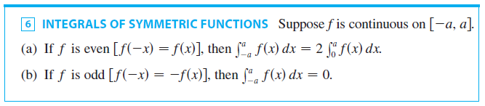
Symmetry
The next theorem uses the Substitution Rule for Definite Integrals to simplify the calculation of integrals of functions that possess symmetry properties.

Slide 36
INTEGRALS OF SYMMETRIC FUNCTIONS PROOF
We split the integral in two:
In the first integral in the second part, we make the substitution u = –x .
Then, du = –dx, and when x = –a, u = a.

Slide 37
INTEGRALS OF SYMMETRIC FUNCTIONS PROOF
Therefore,
So, Equation 7 becomes:

Slide 38
INTEGRALS OF SYMMETRIC FUNCTIONS PROOF (a)
If f is even, then f(–u) = f(u).
So, Equation 8 gives:

Slide 39
INTEGRALS OF SYMMETRIC FUNCTIONS PROOF (b)
If f is odd, then f(–u) = –f(u).
So, Equation 8 gives:

Slide 40
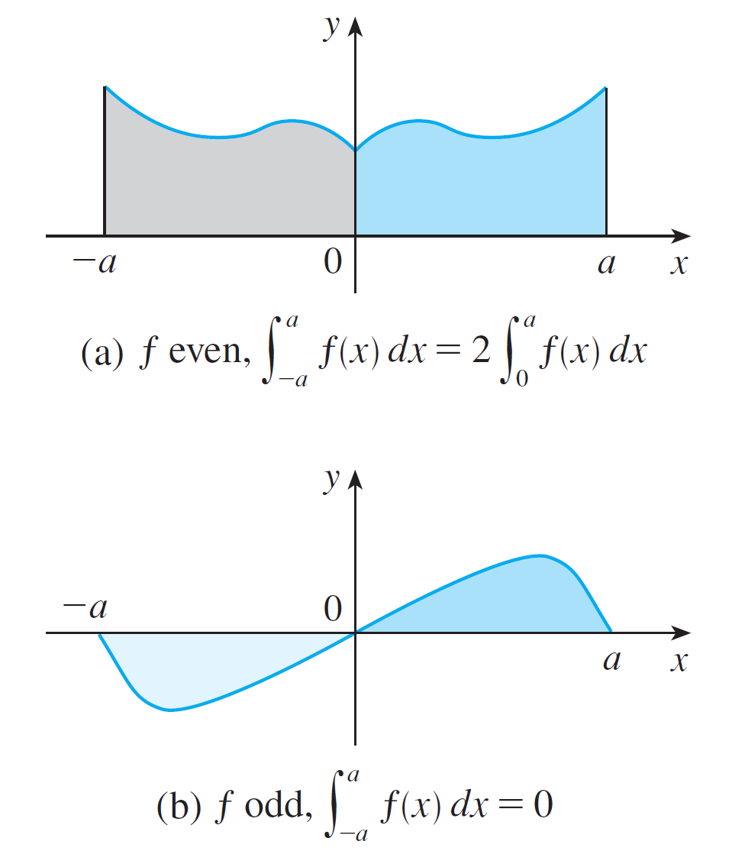
Symmetry
Theorem 6 is illustrated by Figure 2.
Figure 2

Slide 41

Symmetry
For the case where f is positive and even, part (a) says that the area under y = f (x) from –a to a is twice the area from 0 to a because of symmetry.
Recall that an integral can be expressed as the area above the x-axis and below y = f (x) minus the area below the axis and above the curve.
Thus part (b) says the integral is 0 because the areas cancel.

Slide 42
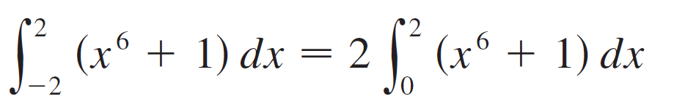

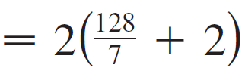
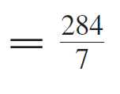
Example 6
Since f (x) = x⁶ + 1 satisfies f (–x) = f (x), it is even and so

Slide 43
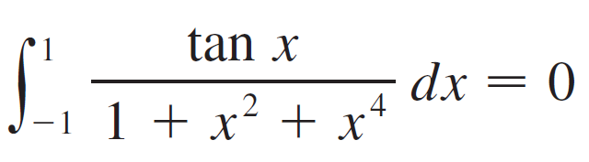
Example 7
Since f (x) = (tan x)/(1 + x² + x⁴) satisfies f (–x) = –f (x), it is odd and so

